Slide 1
木禾心理
University of California, Santa Barbara
心理咨询资源整理 更新于8/7/2021 yx

Slide 2
点击箭头转到相关页面

Slide 3
CAPS概要（内附超链接）
CAPS：
联系方式，收费情况
咨询服务：
Initial Brief Assessment，大部分咨询的第一步，评估并安排后续咨询计划
Short-Term Individual Counseling，短期咨询
Single Session Therapy, 单次治疗，适合有明确目的的同学
Long-Term Individual Therapy，长期治疗，
LiveHealth-Teletherapy，线上咨询平台
Let’s Talk，一对一的20分钟非正式咨询
其他资源：
Outreach，面向学生组织
Group Counseling Programs，学习一些应对压力的技巧
Consultation，咨询他人的心理问题
Crisis Assistance，危机干预

Slide 4
MPH概要（内附超链接）
MHP：
联系方式
服务简介
服务介绍：
Massage & Egg Chairs
Drop-in Peer Support
School Anxiety Program (SAP)
Quarterly Event
Outreach to Campus Groups
Workshops & Trainings

Slide 5
CAPS联系方式
资讯中心名称：Counseling and Psychological Services (CAPS)
资讯中心官方网站: https://caps.sa.ucsb.edu/
Contact information:
Phone(24/7): 805-893-4411
Hours: Monday, Tuesday, Friday 8:30am to 4:30 pm; Wednesday 10:00am to 4:30pm; Thursday 9:00am to 4:30 pm (excluding university holidays)
Location: Counseling and Psychological Services, Building 599, Santa Barbara, CA 93106

Slide 6
收费情况
免费咨询 (university registration fee covers the cost of counseling)
临时取消会有 no-show & late cancelation fee
24小时内取消预约有25美元的cancellation fee
预约时间没有到场会有55美元的no-show fee
出于疾病或者紧急情况取消24小时内的预约时可以填写fee waiver form
有些心理治疗(therapy)会单独收费

Slide 7
Initial Brief Assessment https://caps.sa.ucsb.edu/services/overview-of-services
来到CAPS咨询的第一步就是Initial Brief Assessment，大部分咨询（包括short-term individual counseling, single session therapy 和long term individual therapy）都需要这个评估来进行后续的咨询安排
完成一个10分钟的问卷，然后和心理医生谈一下自己的问题并确定一个适合的计划
打电话(805) 893-4411或者提交一个CAPS Services Request Form
https://docs.google.com/forms/d/e/1FAIpQLSeRqXHcZGMl-IEn38CcVgBxCOgMNIxEkvZ42yKHlLGLK44IfQ/viewform
Hours: Monday through Friday, 10am - 12pm and 1pm - 3pm, wait time can vary (shorter wait times in the morning)
Location: the main CAPS office across from Storke Tower (in the same building with Career Services)
目前线下服务没有开放，通过电话或者zoom完成assessment

Slide 8
Short-Term Individual Counseling https://caps.sa.ucsb.edu/services/short-term-counseling
短期咨询，需要先完成initial brief assessment
第一次咨询通常会在initial brief assessment后的两周内
一共1 - 4次，每2 - 3周安排一次（也有可能会更频繁）
免费（包含在student fee里）

Slide 9
Single Session Therapy https://caps.sa.ucsb.edu/services/single-session-therapy
单次治疗，需要先完成initial brief assessment
适合有明确目的的同学，提供一些解决具体问题的方法，
提前20 - 30分钟到场，填写一些信息，治疗时长大约75分钟
免费（包含在student fee里）
由于疫情，在zoom上进行

Slide 10
Long-Term Individual Counseling https://caps.sa.ucsb.edu/services/long-term-counseling/community-referral
将同学推荐给其他的mental health provider进行长期咨询，需要先完成initial brief assessment
Community Provider: https://caps.sa.ucsb.edu/community-provider-database
大部分长期咨询的第一次都会安排在initial brief assessment后的一周内进行
收费，paid with health insurance：UC Ship前三次免费，后面每次15美元；其他保险具体参考学校网站

Slide 11
LiveHealth-Teletherapy http://livehealthonline.com/
一个线上的咨询平台，有app，不需要CAPS的referral也可以使用
UC Ship没有co-pay，其他保险有co-pay
Hours: 7am to 9pm including weekend appointments

Slide 12
Outreach https://caps.sa.ucsb.edu/outreach
帮助解决学校里学生组织内的问题
至少提前两周提交online request form: https://docs.google.com/forms/d/e/1FAIpQLSdlsIgvl7qz3IfSzkVmTgjeB4EoehqH6kKrtGtVmlP3Vn2xiw/viewform

Slide 13
Group Counseling Programs https://caps.sa.ucsb.edu/services/group-counseling/group-counseling-program-summer-2021
帮助学生学习一些应对压力或者建立团体(build community)的技巧
分为三种：Psychoeducation & Skills Groups; Community Groups; Interpersonal Process Groups
每学期会更新，具体参考CAPS官网
免费（包含在student fee里）
链接会每学期更新，具体信息参考CAPS网站

Slide 14
Consultation https://caps.sa.ucsb.edu/services/consultation
帮助咨询其他人（不是本人）的心理问题
建议同学联系Student Mental Health Coordination Services (805) 893 - 3030或者通过这个链接提交一个online report http://www.sa.ucsb.edu/responding-to-distressed-students/welcome

Slide 15
Crisis Assistance https://caps.sa.ucsb.edu/resources/crisis-assistance
危机干预，直接和本人对话或者向周围的人（包括家人，朋友，教职员工，宿舍工作人员或其他学校工作人员）提供咨询服务
UCSB After-Hours Phone Counseling: 805.893.4411
Emergency/Police/Paramedics: 911 (or 9-911 for on-campus phones)
Suicide Prevention Lifeline: 1.800.273.TALK (8255)
Student Health Social Work Services: 805.893.3087
Distressed Student Response: 805.893.3030
Visit wellbeing.ucsb.edu for more campus resources

Slide 16
MHP联系方式
资讯中心名称：Mental Health Peer Program (MHP)
资讯中心官方网站: http://www.ucsbmhp.com/
Contact information:
Hours: Monday, Tuesday, Thursday, Friday 9:00am to 4:00 pm; Wednesday 10:00am to 4:00pm (excluding university holidays)
Location: Building 434, Room 100 (located between the main CAPS building and South Hall. Directly across the bike back from Storke Tower)
in-person services are temporarily closed

Slide 17
服务简介
http://www.ucsbmhp.com/services.html
和CAPS相比，MHP提供的服务更多关注同学们的压力和心理健康，而CAPS偏向于咨询和解决心理问题
@UCSB Mental Health Peers (@ucsbmentalhealthpeers)：The Mental Health Peers at UCSB's Counseling and Psychological Services (CAPS) help students navigate mental health during college. #SaySomething

Slide 18
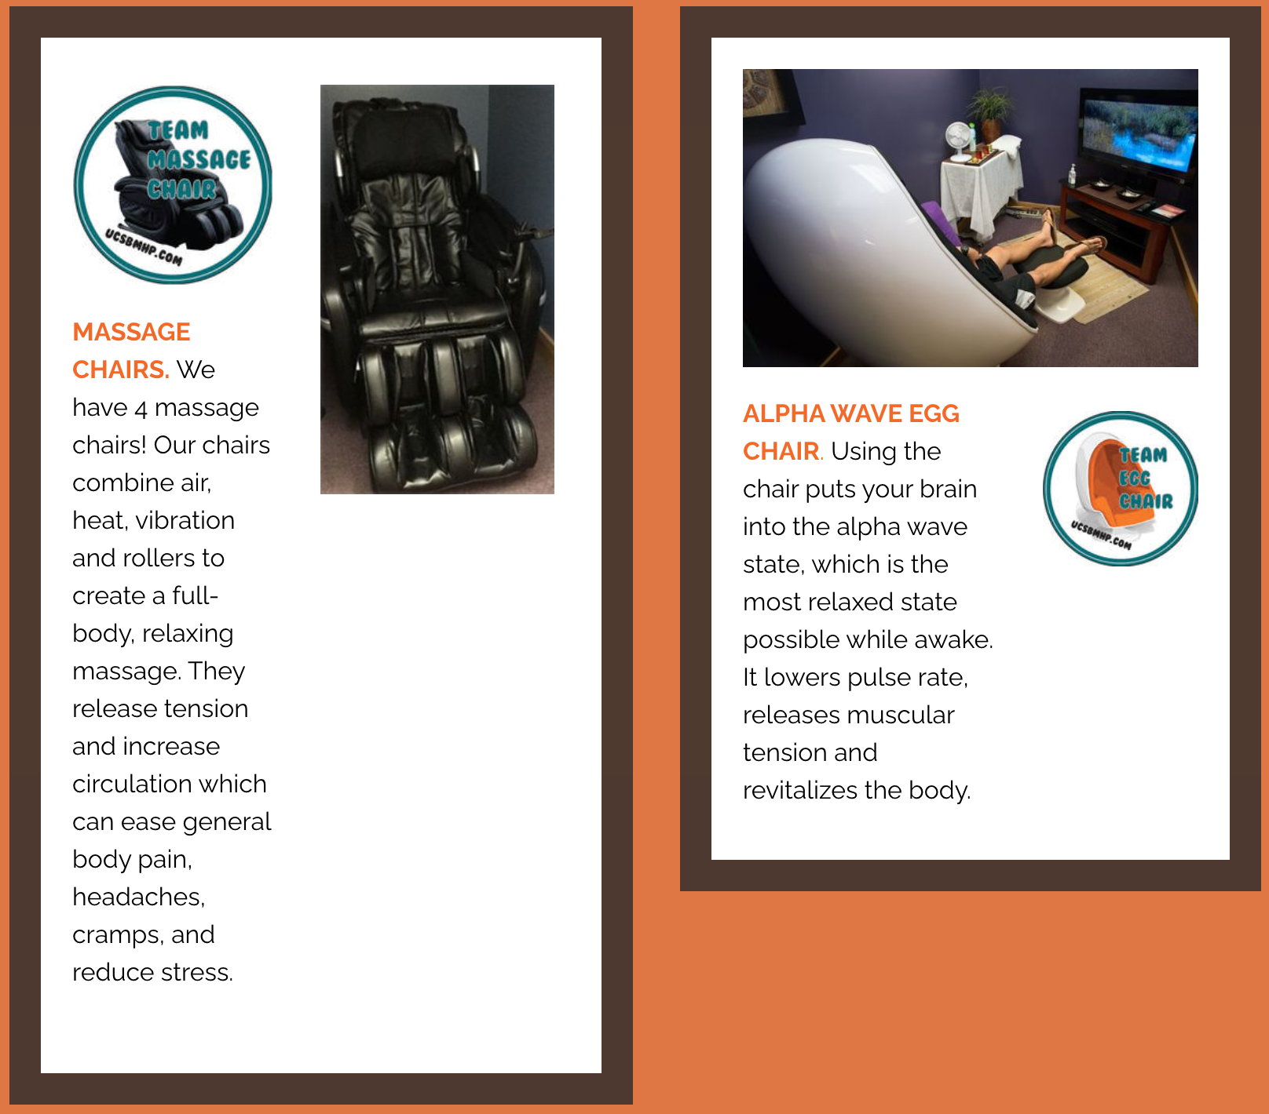
Massage & Egg Chairs
按摩椅和蛋椅，使用前需要签到，先到先得
Location: the main CAPS lobby in Building 434, room 100
Hours:
Monday, Tuesday, Thursday, Friday
9am - 4pm
Wednesday 10am - 4pm
Sign-in at the check-in desk
temporarily closed

Slide 19
Drop-in Peer Support
帮助学生了解学校的资源
Help student get connected to other appropriated resources around campus
temporarily closed

Slide 20
School Anxiety Program (SAP)
3次1个小时和mental health peer的一对一meeting，学习一些时间管理，应对技巧和放松技巧来减少焦虑
Includes up to three 1-hour long 1-on-1 sessions with a mental health peer who will help to learn important time management, coping, and relaxation skills to reduce anxiety
conducted through zoom, sign up online

Slide 21
Quarterly Event
每个学期MHP都会举行一个大型活动来帮助学生更好的了解和解决常见的问题，详情参考Facebook和Instagram上的更新
The MHP host a large event each quarter that helps students to better understand and address common challenges
Check out Facebook and Instagram pages for updates

Slide 22
Outreach to Campus Groups
帮助学校内的学生组织解决一些问题
Reach out to student communities on campus to understand and identify challenging priorities and issues for each group

Slide 23
Workshops & Trainings
6个不同主题的workshop: imposter syndrome; social media & mental health; microaggression; stress reduction; sleep hygiene; bystander training

